Slide 1





Slide 2

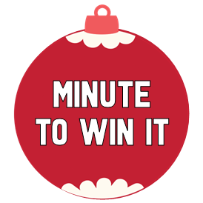






400
100
600
400
300
800
800
600
600
200
200
800
600
400
600
400
200
800
800
300

Slide 3
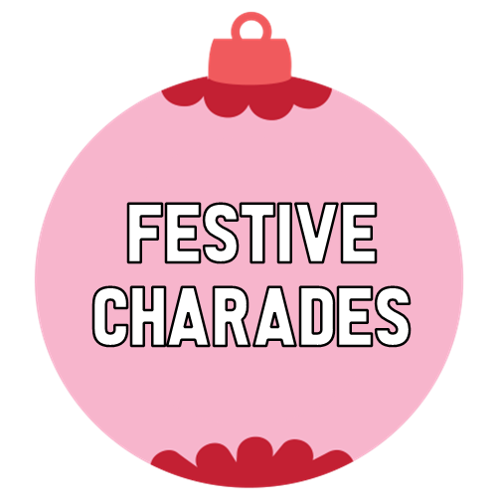




???
???
1000
400
800
???
???
600
???
???
200
???
600
???
???
???
???
1000
400
???

Slide 4







This is just a game sample. In the actual game the category description can be read here – then when you click start timer the challenge would be revealed. Click here to purchase game now. Instant download!
CLICK HERE TO RETURN TO GAME BOARD 1
Click the Red Button to see what happens when teams get the answer wrong. Click the Green Button to show what happens when they get the answer right!
This is where your challenge would show up. Different categories have different challenges. Some challenges appear on the screen, other challenges such as the Minute to Win It challenges and the Reindeer Game challenges are played off screen and what you would find here is the game rules. Every category is a different type of game. This game also comes with somefestive printables that are used for some of the games such as Charade Prompts, Scattergory Cards, etc. Everything you need to know can be found in our included Host Guide. Answer Sheet is also included.
REQUIRED FOR THIS GAME: PowerPoint
RECOMMENDED: Large screen TV to complete that game show feel
Candy Cane Timer slowly dissolves as time runs out and then…POP!

Slide 5
This is just a game sample. In the actual game the category description can be read here – then when you click start timer the challenge would be revealed. Click here to purchase game now. Instant download!
CLICK HERE TO RETURN TO GAME BOARD 2
Click the Red Button to see what happens when teams get the answer wrong. Click the Green Button to show what happens when they get the answer right!
This is where your challenge would show up. Different categories have different challenges. Some challenges appear on the screen, other challenges such as the Minute to Win It challenges and the Reindeer Game challenges are played off screen and what you would find here is the game rules. Every category is a different type of game. This game also comes with somefestive printables that are used for some of the games such as Charade Prompts, Scattergory Cards, etc. Everything you need to know can be found in our included Host Guide. Answer Sheet is also included.
REQUIRED FOR THIS GAME: PowerPoint
RECOMMENDED: Large screen TV to complete that game show feel
Candy Cane Timer slowly dissolves as time runs out and then…POP!

Slide 6

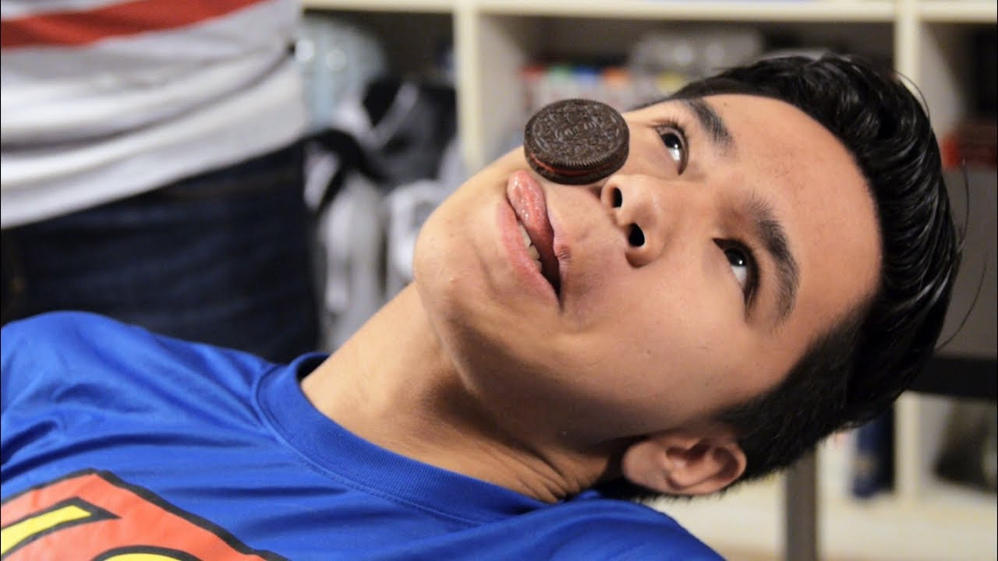
Choose one member from each team to compete in the challenge. Players are racing against the timer, not each other. Every player that completes the task within one minute gets the points!
COOKIE FACE-OFF:
Each player starts with a cookie on their forehead. Using only your facial muscles, move the cookie down into your mouth. You can’t touch the cookie with your hands!
SAMPLE

Slide 7
ONE PLAYER FROM YOUR TEAM IS THE GUESSER – THEY STAND WITH THEIR BACK TO THE SCREEN. The other players on your team shout out clues to get their guesser to say each word or phrase. When they say the game word they get a new word. The goal is to get as many words as you can in a minute.
This is just a sample – click on the purple box to reveal prompts.
RULES
NO SAYING ANY PART OF THE WORD
NO RHYMING
NO SPELLING
NO POINTING TO OBJECTS
NO USING PROPS
YOU CAN PASS ON A CLUE BUT IT COST 2 POINTS
SCORING
EACH POINT IS WORTH 25 POINTS
IF YOU COMPLETE THEM ALL YOU GET A BONUS 200 POINTS
FIREPLACE
BLUE
CHRISTMAS
SHOPPING
SLEDDING
JINGLE
BELLS
FROSTY THE
SNOWMAN
ELF
MISTLETOE
GINGERBREAD COOKIES
NORTH POLE
BLUE
CHRISTMAS
HOT
CHOCOLATE
WRAPPING PAPER
HOME
ALONE
LETTER
TO SANTA
STOCKINGS

Slide 8
The team who chose this chooses one player to be the actor. All the teams choose one member to be their guesser. The actor gets a minute and a half on the clock to act out as many as the charade prompts as they can. Once one prompt is guessed correctly the actor can pull another prompt from the bowl.
RULES
TIME STARTS AFTER ACTOR PULLS OUT FIRST PROMPT
ACTOR CAN NOT SPEAK, POINT, OR USE PROPS
ONLY THE DESIGNATED GUESSERS CAN GUESS
ONCE THE PROMPT IS GUESSED THE ACTOR CAN PULL OUT THE NEXT PROMPT. THEY CAN PASS ON ONLY ONE PROMPT OF THEIR CHOOSING.
SCORING
EACH CORRECT GUESS IS WORTH 200 PTS FOR THAT TEAM.
THE TEAM THAT GETS THE MOST POINTS GETS TO CHOOSE NEXT PROMPT.
A TIE IS BROKEN BY A ROLLING DICE – HIGHEST ROLL WINS.
THIS IS JUST A SAMPLE – PURCHASED GAME INCLUDES PRINTABLE PROMPTS!

Slide 9
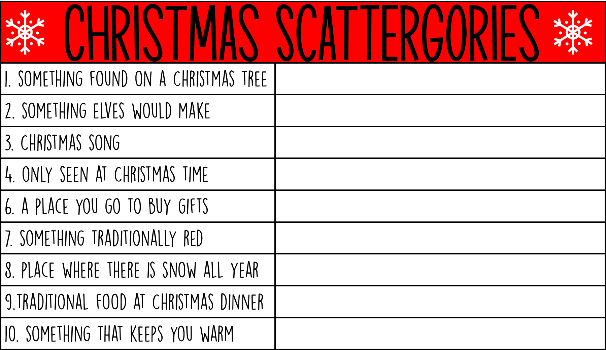









Each teams gets a red scattergories card. The team who chose this topic gets to choose one of the nine gifts in order to reveal a letter. the timer will then be started. Teams fill in their card with answers that begins with that letter. When time is up players compare answers. Duplicate answers get zero point. Unique answers get 100 points each for their team. Team with the most points chooses next topic.
C
h
r
I
S
t
m
a
s
THIS IS JUST A SAMPLE – PURCHASED GAME INCLUDES PRINTABLE GAME CARDS!

Slide 10
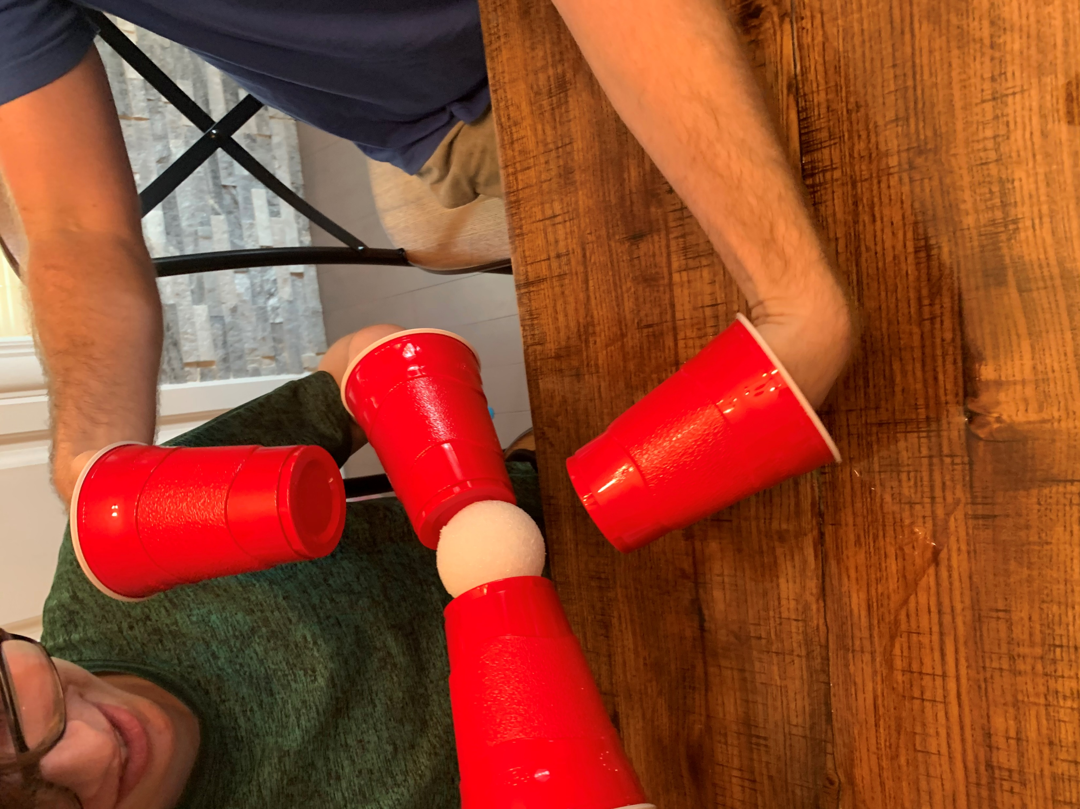
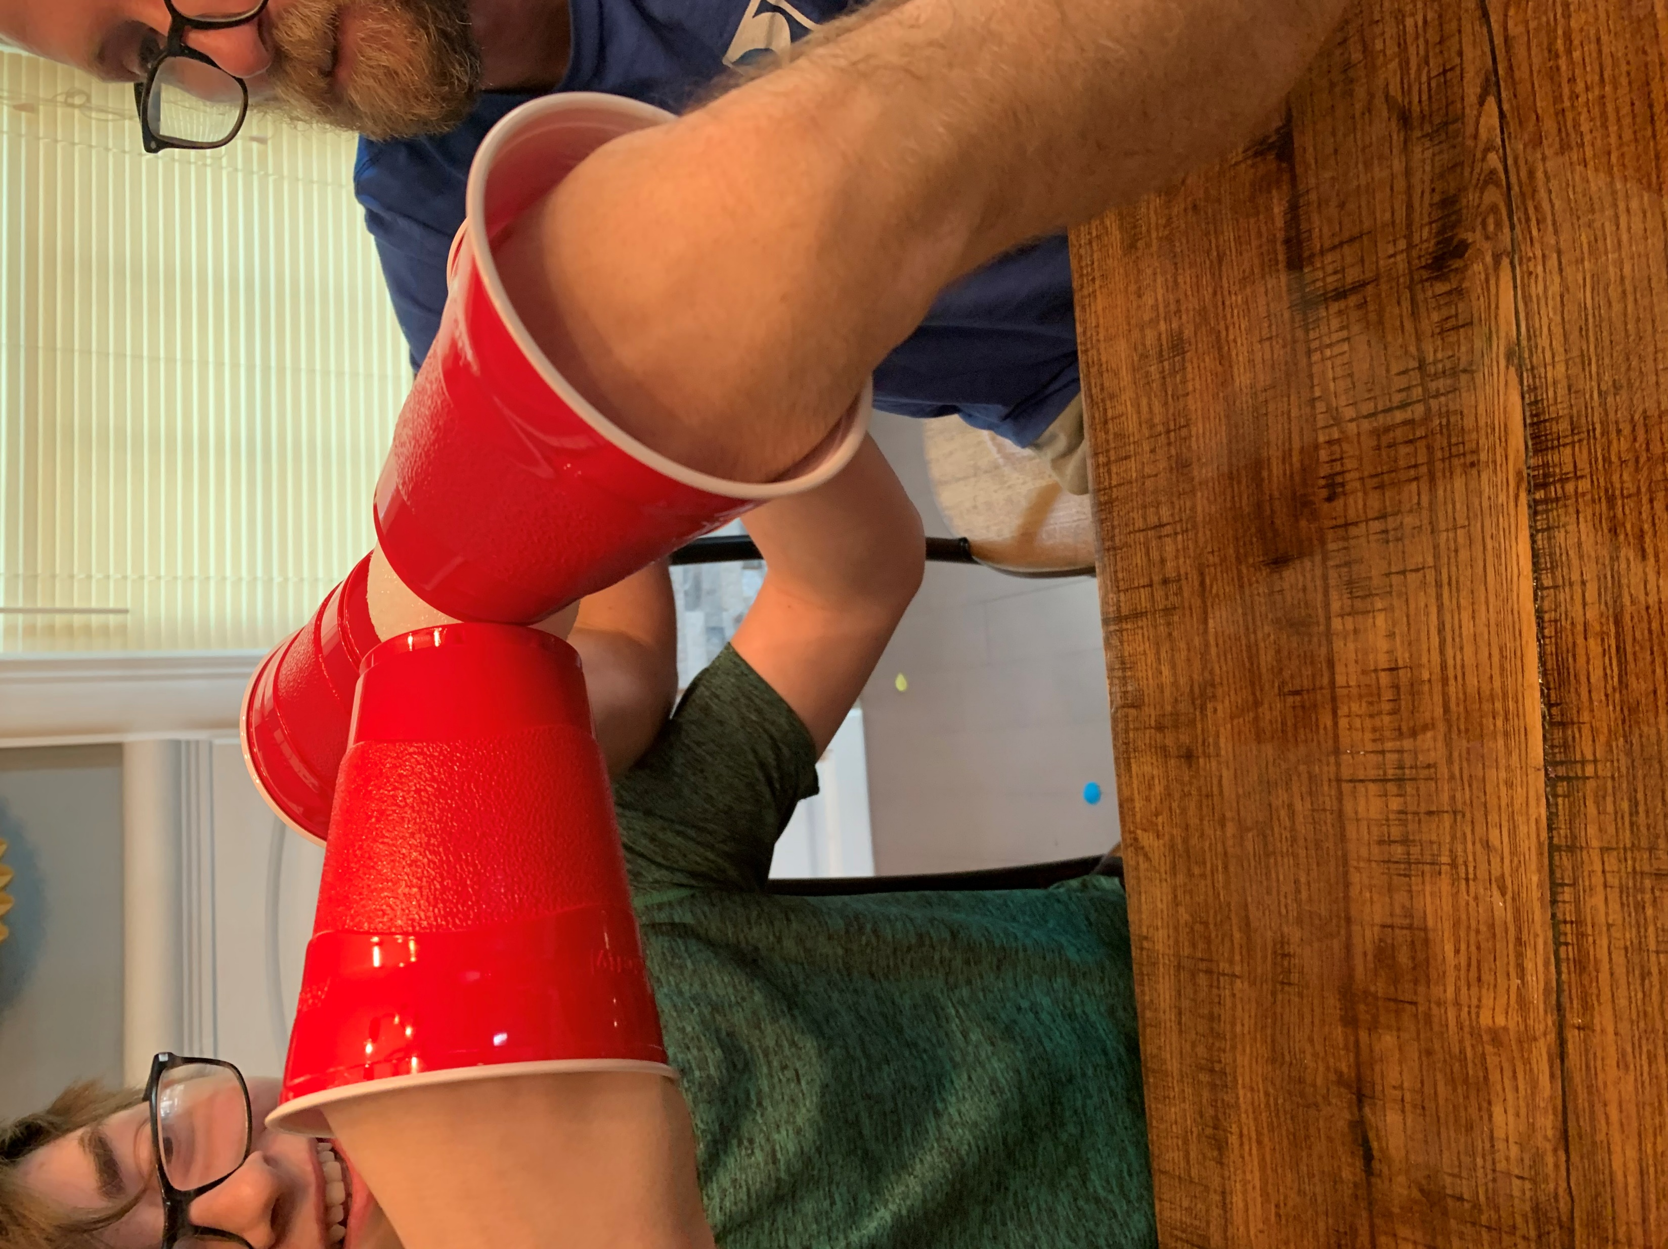
welcome to reindeer games! In these games, unlike the minute to win it games, you are not racing against the clock you are racing against each other. No timer – the first team that completes the task according to the rules wins the points.
Reindeer Hoofs : All players on your team participate.
The team sits shoulder to shoulder in a line. Each player puts plastic cups over their hands to create the reindeer hoofs.
On one side of the team is a bowl with five jingle bells in it, on the other side is an empty bowl. Players must pass each jingle bell down the line to the other side using only their hoofs. The last player putting dropping it in a bowl.
The first team to get all five in their end bowl wins 600 points.
SAMPLE

